Slide 1
Viz-ing your Data!
Tan Shi Hui

Slide 2
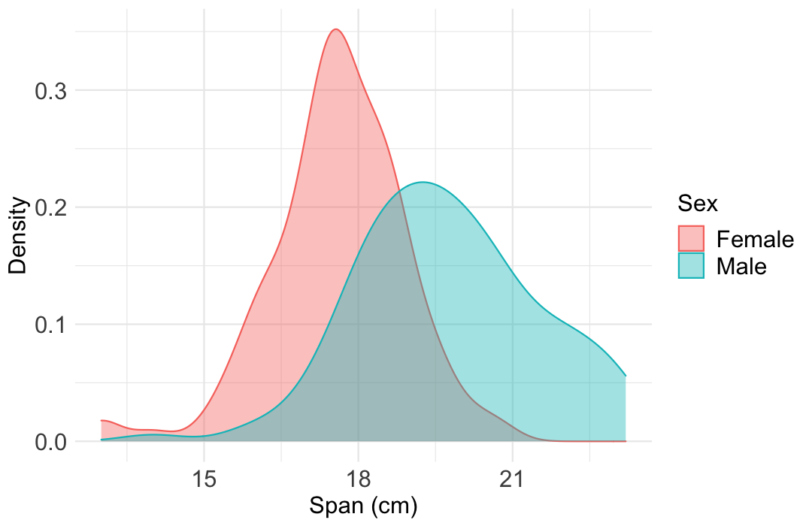
Viz-ing your Data!
Viz 1
Density
About | A density plot shows the distribution of a numeric variable.
Type of Data | Numerical Numerical & Categorical
Number of Variables | 1 2
Useful for Displaying | Distribution
R Package | ggplot2
R Function | geom_density
R sample code | ggplot(data = dat) + geom_density(aes(x = span, group = sex))

Slide 3
Viz-ing your Data!
Viz 1
Density
About | A density plot shows the distribution of a numeric variable.
Type of Data | Numerical Numerical & Categorical
Number of Variables | 1 2
Useful for Displaying | Distribution
R Package | ggplot2
R Function | geom_density
R sample code | ggplot(data = dat) + geom_density(aes(x = span, group = sex))

